Slide 1
Impact of Customers Leaving
2016

Slide 2
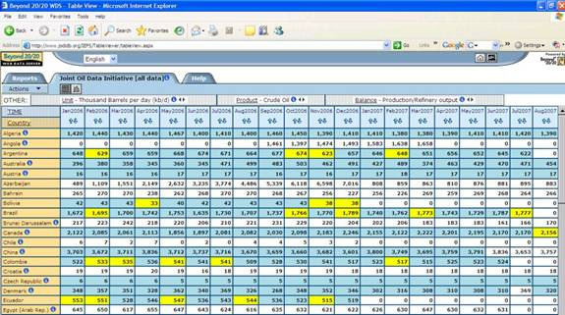
What Happens When Transactions Are Down?
Why are transactions down?
It starts with this.
And leads to this
And then leads to this….
Confused about what to do next?
Why isn’t the answer here? There must be something else.

Slide 3
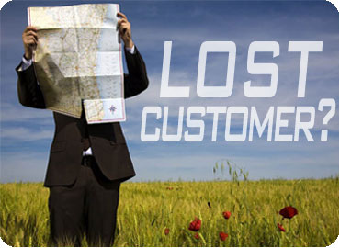
What’s the Underlying Question?
While a decline in transactions is determined by internal data, the reasons why are speculations unless you talk to those who have not shopped. This is where customer insight from the market comes in.
WHY?

Slide 4
What are the Underlying Questions?
First, identify those who used to shop with you but have not transacted recently.
Then determine what they used to buy from you.
Next ask:
If they are still buying it?
Where are they buying it?
Why are they not buying from you?
What it would take to get them back?
Always ask WHY! Numbers without the explanation will not tell the entire story.

Slide 5
What Does This Mean?
By talking to customers and, asking the right questions, you can determine the reasons for customers not buying this product from you.
Why is this important?
If customers have money in hand but cannot buy from you, they are disappointed.
And, because they have to shop at a competitor, they are at risk for shopping there more often.

Slide 6
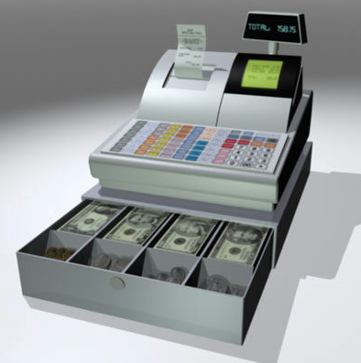
What is the Impact?
To illustrate this, let’s assume the database has reveled that there is a 15% decline or 90,000 units sold.
Furthermore, customers spent an average of $10 on this product that they used to buy from you.
And through the process of talking to customers, it is determined that 75% of these customers bought this item from a competitor.
This means that $675,000 of sales from your customers went into the competitors’ cash registers.
And this was just one item!
Once customers have a good experience at one place, they tend to go back there. So how many customers will be completely lost?

Slide 7
How to Get Them Back?
By understanding why they left, like price, out of stock, selection, etc., action plans must be created to reduce lost opportunity.
If for instance the issue is that customers said the product was out of stock, creating messaging that talks about a great value for this item will only drive more shoppers in the door, who will be disappointed because it is not on the shelf.
A deeper dive into the process will determine where the out of stock breakdown is. Maybe inventory levels? Maybe stocking? Maybe delivery issues?
But the correct action plan will correct the issue.
Then the appropriate message can be created to drive customers in, who will have a better experience.

